Slide 1
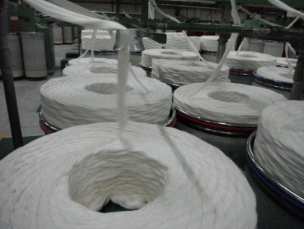
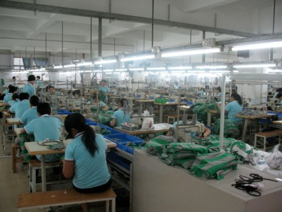
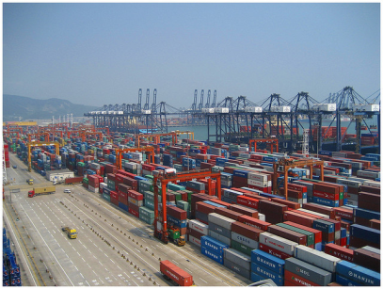
Global Textiles and Apparel Industries
MDSE 4010
Instructor: Dr. Dee K. Knight
Office: Chilton 331
Phone: 940.565.3263
Virtual Office Hours: Tuesday & Thursday 7-8
Campus Office Hours: By appointment
Course Description:
An overview of global textile and apparel industries in terms of production, distribution, and consumption. Major topics include textile and apparel industries with emphasis on global issues concerning manufacturing, labor, consumers and policy makers; and factors affecting processes from the production through distribution in the global textiles and apparel industries.
Course Objectives:
At the completion on the course, students should be able to
Understand the historical and theoretical development of production and consumption in the textile and apparel industries from a global perspective.
Recognize the competitiveness of the U.S. textile and apparel sectors for the global marketplaces.
Analyze economic, social, political and cultural factors related to the global textile and apparel industries, with an emphasis on implications for manufacturers, retailers, and consumers.
Predict major international issues on product development, sourcing, consumption and trading in the textile and apparel sector.
Articulate in written and oral formats your understanding of global textiles and apparel industries as they relate to professional and practical managements.
Textbook:
Kunz, G. I. & Garner, M. B. (2011). Going global: The Textile and apparel industry. New York: Fairchild.

Slide 2
Course Structure
Online courses require careful time management and self discipline. The course is structured around weekly modules and two exams that will be administered on the Denton campus in the Sage Testing Center.
Weekly Modules
A weekly module will open early every Friday morning and include the following:
Pre-Quiz – (5 points), not graded, but will give you a preview of the module.
Weekly module – some combination of course content, videos, and assignments.
Assignments – will be found within the weekly module and will include assignment guidelines and submission instructions. Please note that late assignments are not accepted, so please plan accordingly.
Module Quiz – (10 points) to give students a benchmark for their mastery of course content. Please note that quizzes will cover both content in the textbook and content in the modules.
Exams
Friday, October 12, 2012 at 8 am in Sage Hall Testing Center, Denton campus
Saturday, December 8, 2012 at 10 am in Sage Hall Testing Center, Denton campus
Assignment Format
Unless otherwise specified, assignments are to be computer generated, double spaced with 12-point font and one-inch margins.
It is expected that assignments will be free of spelling, grammatical and spacing errors to avoid deductions.
All assignments must include the student’s name, title of assignment, and due date.
Communications
Use BB Learn email to communicate with the instructor and other students enrolled in the course. If you have an emergency and need immediate assistance please contact me at Dee.Knight@unt.edu and put MDSE 4010 and your name in the subject line.
Remember that you will receive communications from UNT and CMHT using your MyUNT email address. If you do not check your UNT email address, please have communications forward to an address that you do check to avoid missing timely information. You can also contact me by phone and feel free to come to my office. To ensure that I am in my office, it is best to make an appointment by sending me an email with dates/times you are available.
Assessment Methods
Students should access and follow all instructions found in the weekly BB Learn modules.
Pre-quizzes - Students will complete an ungraded pre-quiz before each content module (up to 60 points)
Module quizzes – Student will complete a graded quiz for each content module ( up to 120 points)
Week assignments – The nature of assignments vary and point values will vary (up to 400 points). Please carefully read and follow assignment guidelines and submission instructions. Assignments should be submitted as a Word document unless otherwise specified.
Mid-term exam – 100 points – Sage Hall, Denton campus – see schedule
Final exam – 100 points – Sage Hall, Denton campus – see schedule

Slide 3
Incompletes It is the College of Merchandising, Hospitality and Tourism policy that a grade of “I” will be assigned only in the rarest of circumstances and only when the student has successfully completed almost all of the course requirements. For example, an illness or accident that prevented the student from taking the final exam or military duty would constitute justification for an “incomplete.” In the event of other circumstances, students are encouraged to drop the course.
Course Policies
Copyright Notice
Some or all of the materials on this course Web site may be protected by copyright. Federal copyright law prohibits the reproduction, distribution, public performance, or public display of copyrighted materials without the express and written permission of the copyright owner, unless fair use or another exemption under copyright law applies.
Syllabus Change Policy
Changes to the syllabus, course information, and/or due dates may be made when it is deemed by the instructor to benefit students.
Course Evaluation
The instructor values feedback and asks that you complete the Student Evaluation of Teaching Effectiveness (SETE) at the conclusion of the course. This evaluation form will be accessed through your MyUnt home page near the end of the semester.
Scholarly Expectations
All work submitted for credit must be original works created by the student uniquely for this course. It is considered inappropriate and unethical to make duplicate submissions of a single work for credit in multiple classes, unless specifically requested by the instructor. Non-compliance with this policy can result in failure in the course and action by the University.
UNT POLICIES
Academic Honesty Policy You are encouraged to become familiar with the University's Policy of Academic dishonesty found in the Student Handbook. The content of the Handbook applies to this course. If you are in doubt regarding the requirements, please consult with me before you complete any requirements of the course.
ADA Policy The University of North Texas is on record as being committed to both the spirit and letter of federal equal opportunity legislation; reference Public Law 92-112 – The Rehabilitation Act of 1973 as amended. With the passage of new federal legislation entitled Americans with Disabilities Act (ADA), pursuant to section 504 of the Rehabilitation Act, there is renewed focus on providing this population with the same opportunities enjoyed by all citizens.

Slide 4
As a faculty member, I am required by law to provide "reasonable accommodations" to students with disabilities, so as not to discriminate on the basis of that disability. Student responsibility primarily rests with informing faculty of their need for accommodation and in providing authorized documentation through designated administrative channels. Information regarding specific diagnostic criteria and policies for obtaining academic accommodations can be found here. Also, you may visit the Office of Disability Accommodation in the University Union (room 321) or call us at (940) 565-4323.
Important Notice for F-1 Students taking Distance Education Courses:
University of North Texas Compliance To comply with immigration regulations, an F-1 visa holder within the United States may need to engage in an on-campus experiential component for this course. This component (which must be approved in advance by the instructor) can include activities such as taking an on-campus exam, participating in an on-campus lecture or lab activity, or other on-campus experience integral to the completion of this course. If such an on-campus activity is required, it is the student’s responsibility to do the following:
(1) Submit a written request to the instructor for an on-campus experiential component within one week of the start of the course.
(2) Ensure that the activity on campus takes place and the instructor documents it in writing with a notice sent to the International Student and Scholar Services Office. ISSS has a form available that you may use for this purpose. Because the decision may have serious immigration consequences, if an F-1 student is unsure about his or her need to participate in an on-campus experiential component for this course, s/he should contact the UNT International Student and Scholar Services Office (telephone 940-565-2195 or email internationaladvising@unt.edu) to get clarification before the one-week deadline.
If you hold an F-1 Visa, please bring the required form to me for signature by September 7, 2012. Send me an email to ensure that I am in the office when you come. On-campus meetings for F-1 Visa students are scheduled for Friday, September 28 at 8 am and Friday, October 19 at 8 am in Chilton 331 (conference room). I look forward to meeting with you.

